Slide 1
Business Analytics & AI
Seayoung Rhee
Giampaolo Battaglia
Notes:
The purpose of this video is to help showcase how Microsoft Business Analytics and AI can help a customer transform their business processes.

Slide 2
Convergence accelerates digital transformation
Cloud
Data
Intelligence
Notes:
The fundamental customer challenge of how you get actionable insights from your data has not changed. However, in the last few years, we’ve seen significant trends impact our ability to leverage data to accelerate business.
The Cloud now enables elastic compute and storage at low cost. The availability of new types of data from sensors, devices, social platforms and third party sources allows us to better predict outcomes. The sudden growth and popularity of AI that is enabling new scenarios is a direct outcome of the availability of large volumes of data and the ability to store and process them at low cost.

Slide 3
Digital Transformation
Engage customers
Empower employees
Optimize operations
Transform products
Notes:
The convergence of these trends - Cloud, Big Data and AI - is accelerating the pace at which companies can transform their business processes.
They’re finding new ways to engage customers, empower employees, optimize operations and transform products.

Slide 4
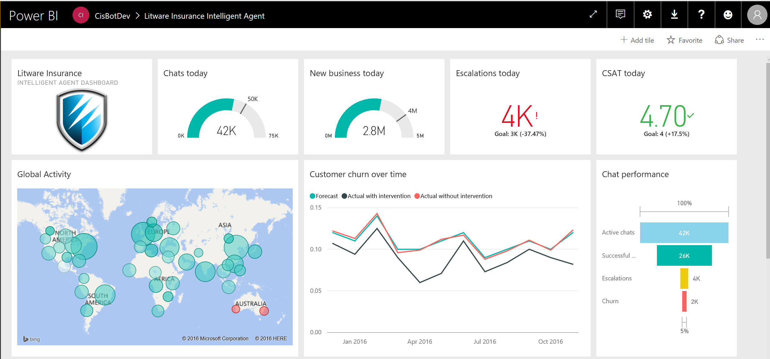
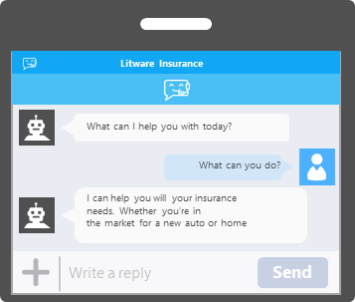
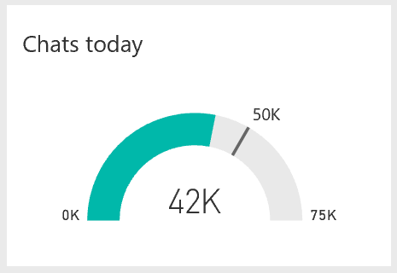

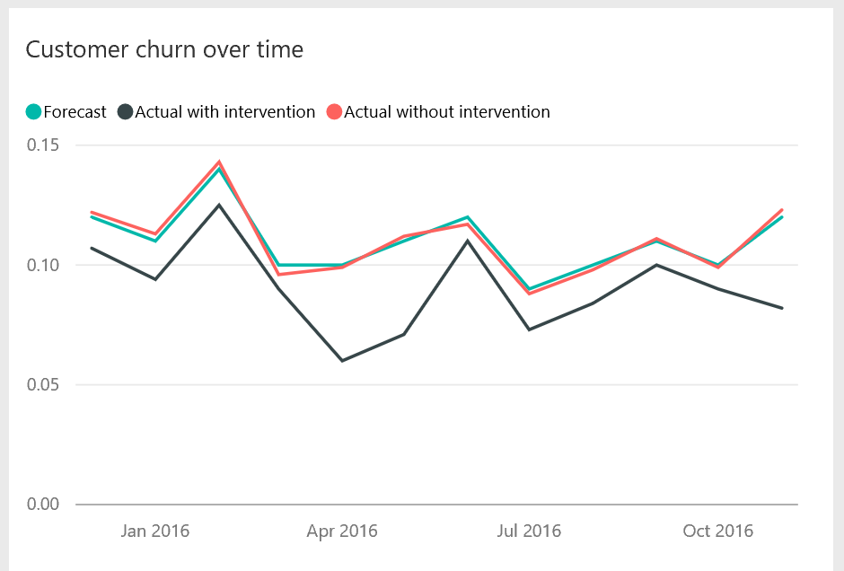

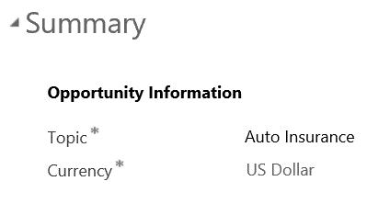
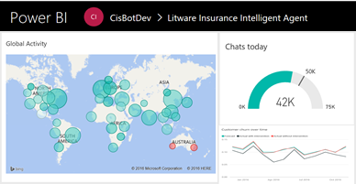
Litware Insurance
What can I help you with today?
What can you do?
Intelligent customer service
I can help you will your insurance needs. Whether you’re in the market for a new auto or home
Write a reply
Send
Interact via personalized conversations
Predict and minimize churn
Account
ABC Customer
Account
Call Schedule
Primary Contact
Preferred method of Contact
Owner
Annual Revenue
Claims assessment call scheduled
08:23 AM
DFC Administrator
Credit Limit
DFC Support Cases
Case Associated View
Filter:
All
Title
Include:
Related *Regarding” Records
Case Number
Portal timesheets
Call Status
Created on
Payrolls
Active
6.14.2013 9:18 AM
DFC-05980-GF90810
Resolved
7.24.2013 6:24 AM
DFC-05980-GF90917
Voiding a payrolls
Resolved
9.11.2013 3:50 PM
DFC-05980-GF90989
2011 times card
Resolved
1.26.2014 4:48 PM
A
All
B
C
D
E
F
G
H
I
J
K
L
M
N
O
P
Q
R
S
T
U
V
W
X
Y
Z
CUSTOMER
CUSTOMER SUPPORT AGENT
Take action in real time
VP OF OPERATIONS
Notes:
In this demo, we will show you how an insurance company can leverage business analytics and AI to fundamentally transform the way they do customer service and reduce customer churn.
We’re going to walkthrough 3 scenarios:
The first is how customers can interact with the solution via personalized conversations automated with Bots
The second is how the customer service support agent gets benefits from Machine Learning and Analytics to predict and minimize churn
The third is how the VP of operations can monitor global activity via real-time dashboards and take action

Slide 5
Demo: Intelligent Customer Care
Built with Cortana Intelligence

Slide 6
Intelligent solutions enable you to…
Deepen
Engagement
Predict
Outcomes
Automate
Actions
Notes:
To summarize, in this solution, Business Analytics and AI helped me deepen my customer engagement, predict outcomes and helped reduce churn and automate actions by allowing my VP of operations to make real time adjustments to competitive price pressures.

Slide 7
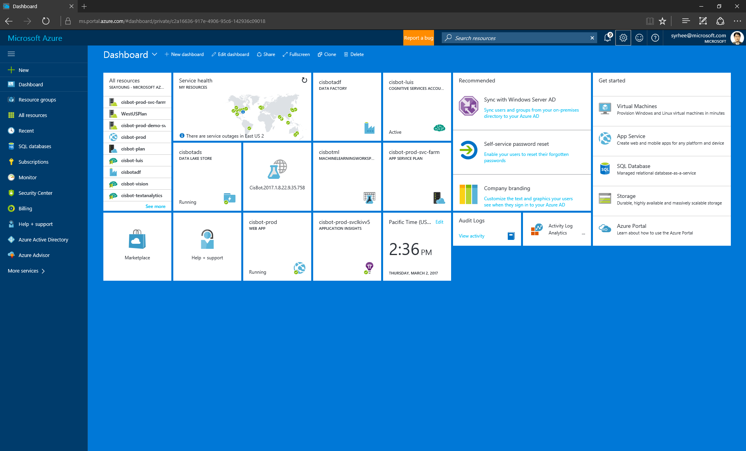
Notes:
Everything you saw here was built by 2 developers in a month, using our BA and AI capabilities on the Cloud.

Slide 8
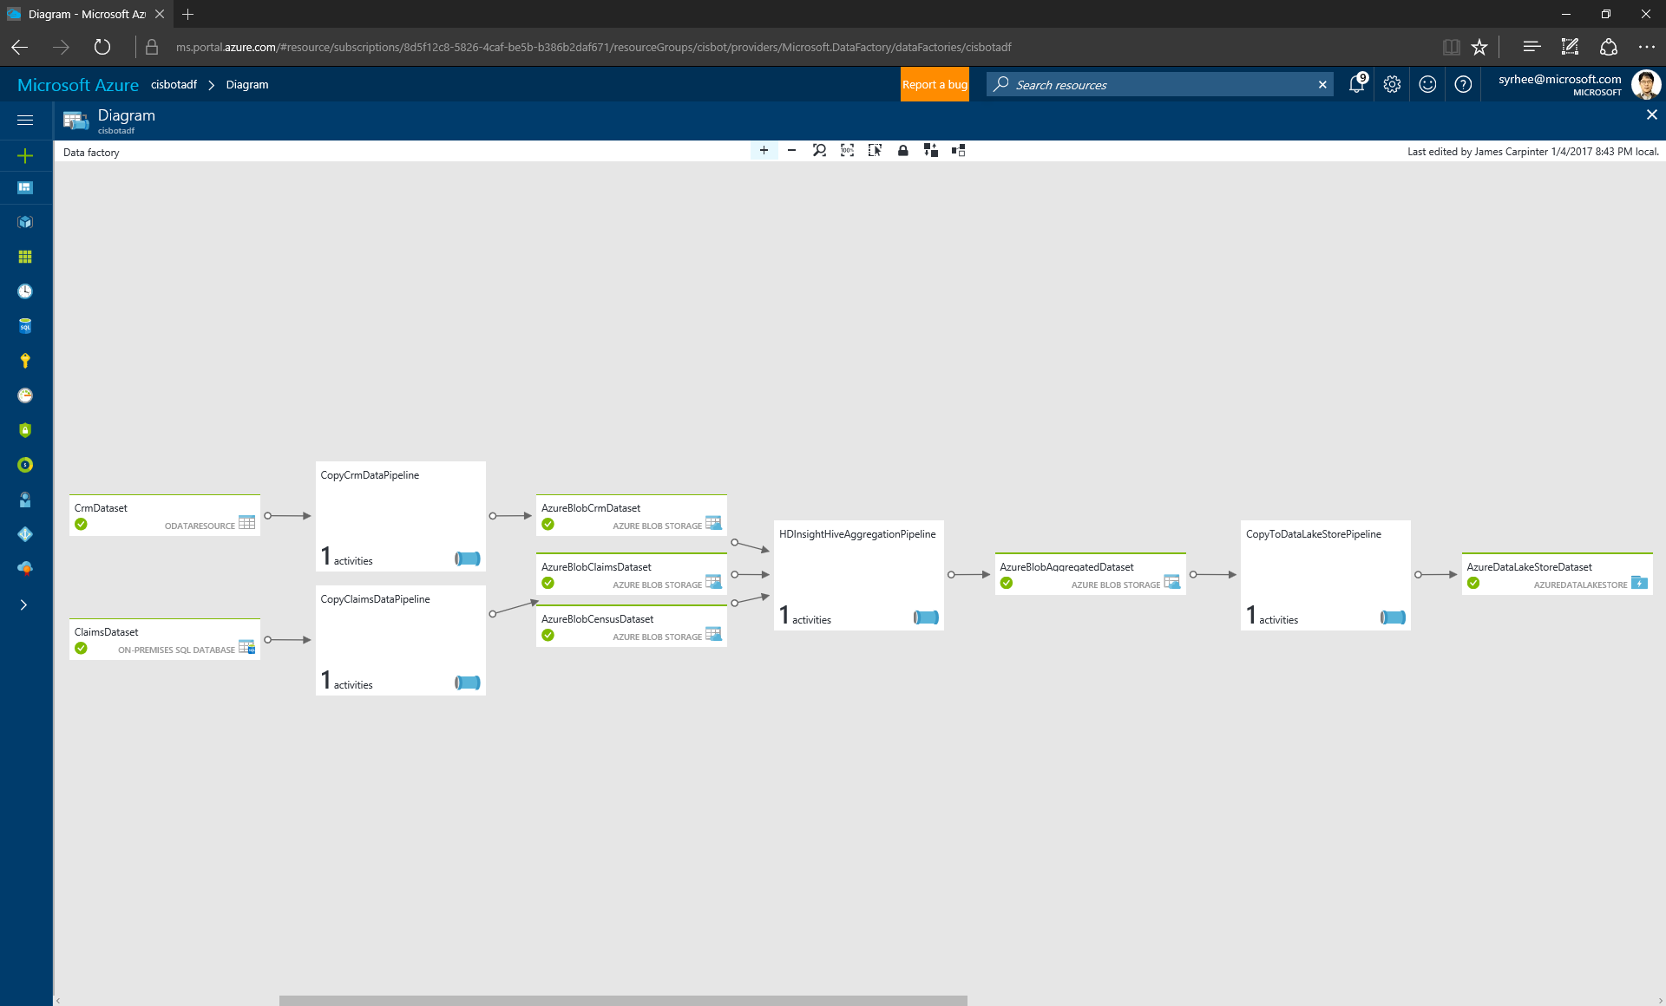
Notes:
The view here (DF View) is a simple behind the scenes view to explain how the services come together to accelerate transformation.

Slide 9


Cortana Intelligence
Transform data into intelligent action
Information Management
Big Data Stores
Machine Learning and Analytics
Intelligence
Data Sources
People
Data Factory
Data Lake Store
Machine Learning
Cognitive Services
Data Catalog
SQL Data
Warehouse
Data Lake Analytics
Bot Framework
Web
Apps
Event Hubs
DocumentDB
HDInsight
Cortana
Mobile
Apps
Stream Analytics
Bots
Dashboards & Visualizations
Azure Analysis Services
Sensors and devices
Power BI
Automated Systems
Data
Intelligence
Action
Notes:
All of this was build using Cortana Intelligence services and Dynamics 365.

Slide 10






































Intelligent solutions in action
Retail & Consumer Goods
Discrete Manufacturing
Government & Education
Healthcare
Banking & Financial Services
Professional Services
Notes:
This is just one example of how Business Analytics and AI can help transform the business process for an organization. We have customers across every industry with similar stories for transformation:
- For example, Rockwell, a global industrial automation company, who cut develop time by 80% and costs up to 90% by providing full time pipeline visibility,
- or, QuarterSpot, a start up in the financial sector, who lowered loan defaults by 50%, leading to increased profitability

Slide 11
Thank You!
Notes:
With that, we’d like to conclude today’s presentation. Thank you.

